Slide 1
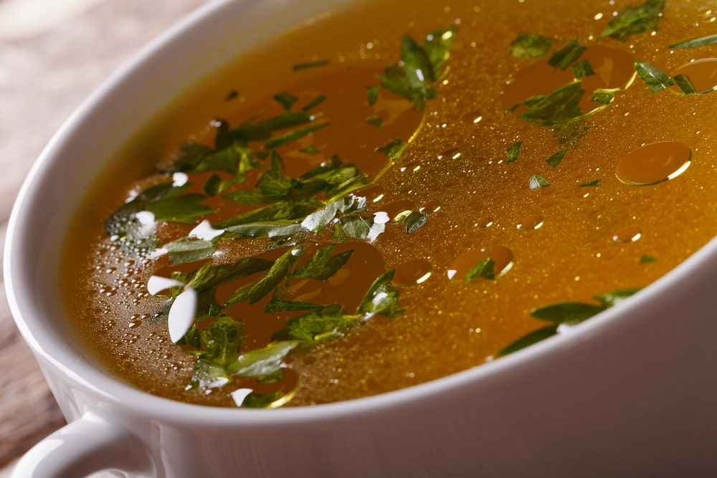
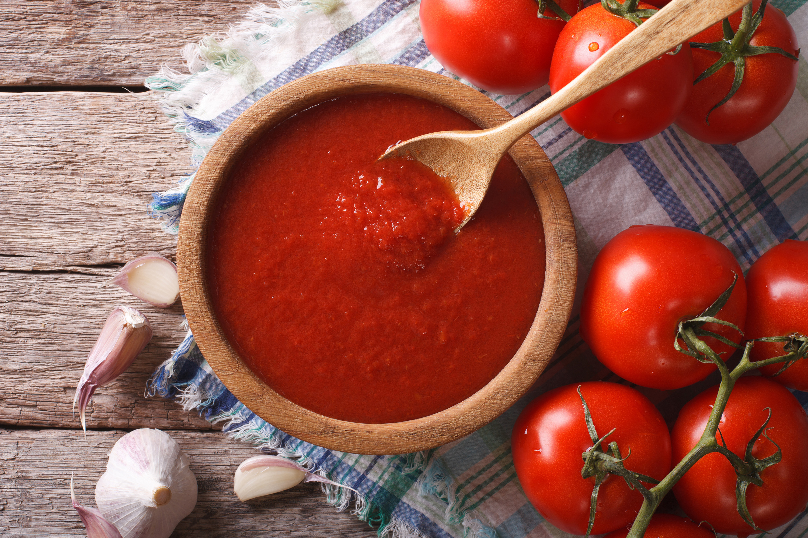
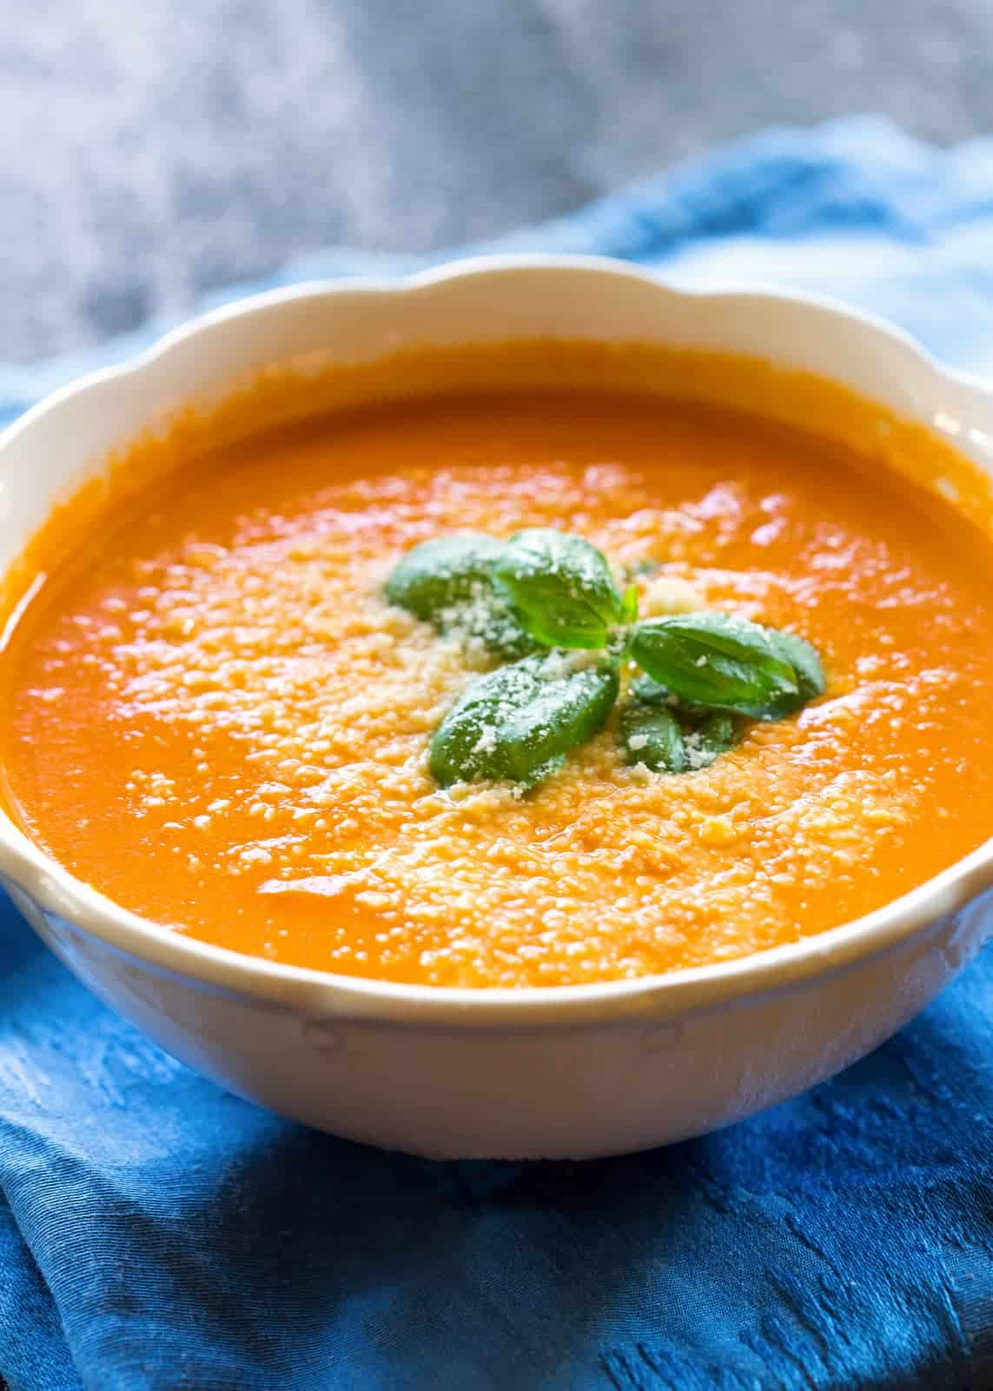
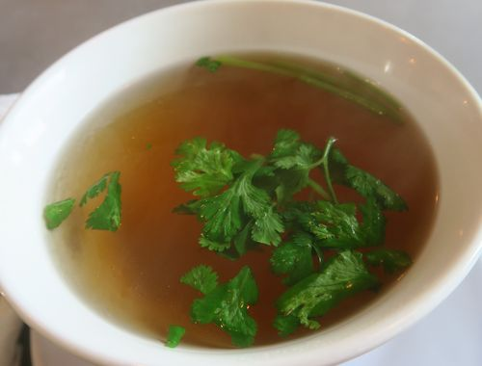
Prepare Stock, Sauces and Soups

Slide 2
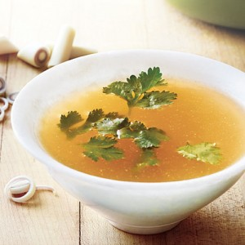
Principles of Preparing Stocks

Slide 3
STOCKS
Stocks- are among the most basic preparations found in professional kitchen. They referred to in French as fonds de cuisine, or "the foundation of cooking." It is a flavorful liquid prepared by simmering meaty bones from meat or poultry, seafood and/or vegetables in water with aromatics until their flavor, aroma, color and body, and nutritive value are extracted. a clear, thin liquid flavored by soluble substances extracted from meat, poultry, and fish; and their bones, and from vegetables and seasonings.

Slide 4
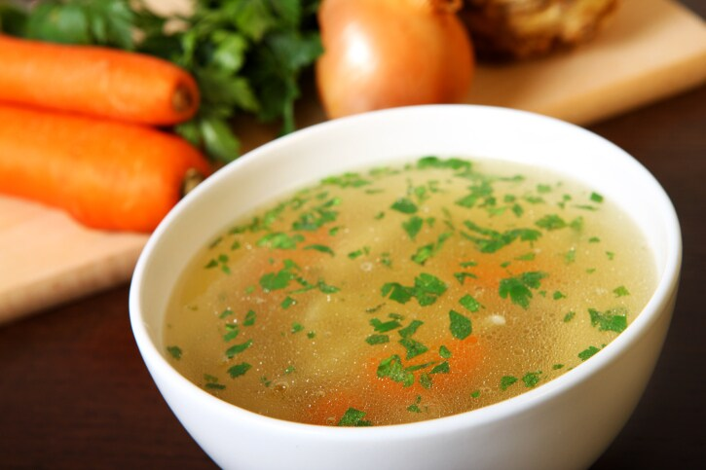
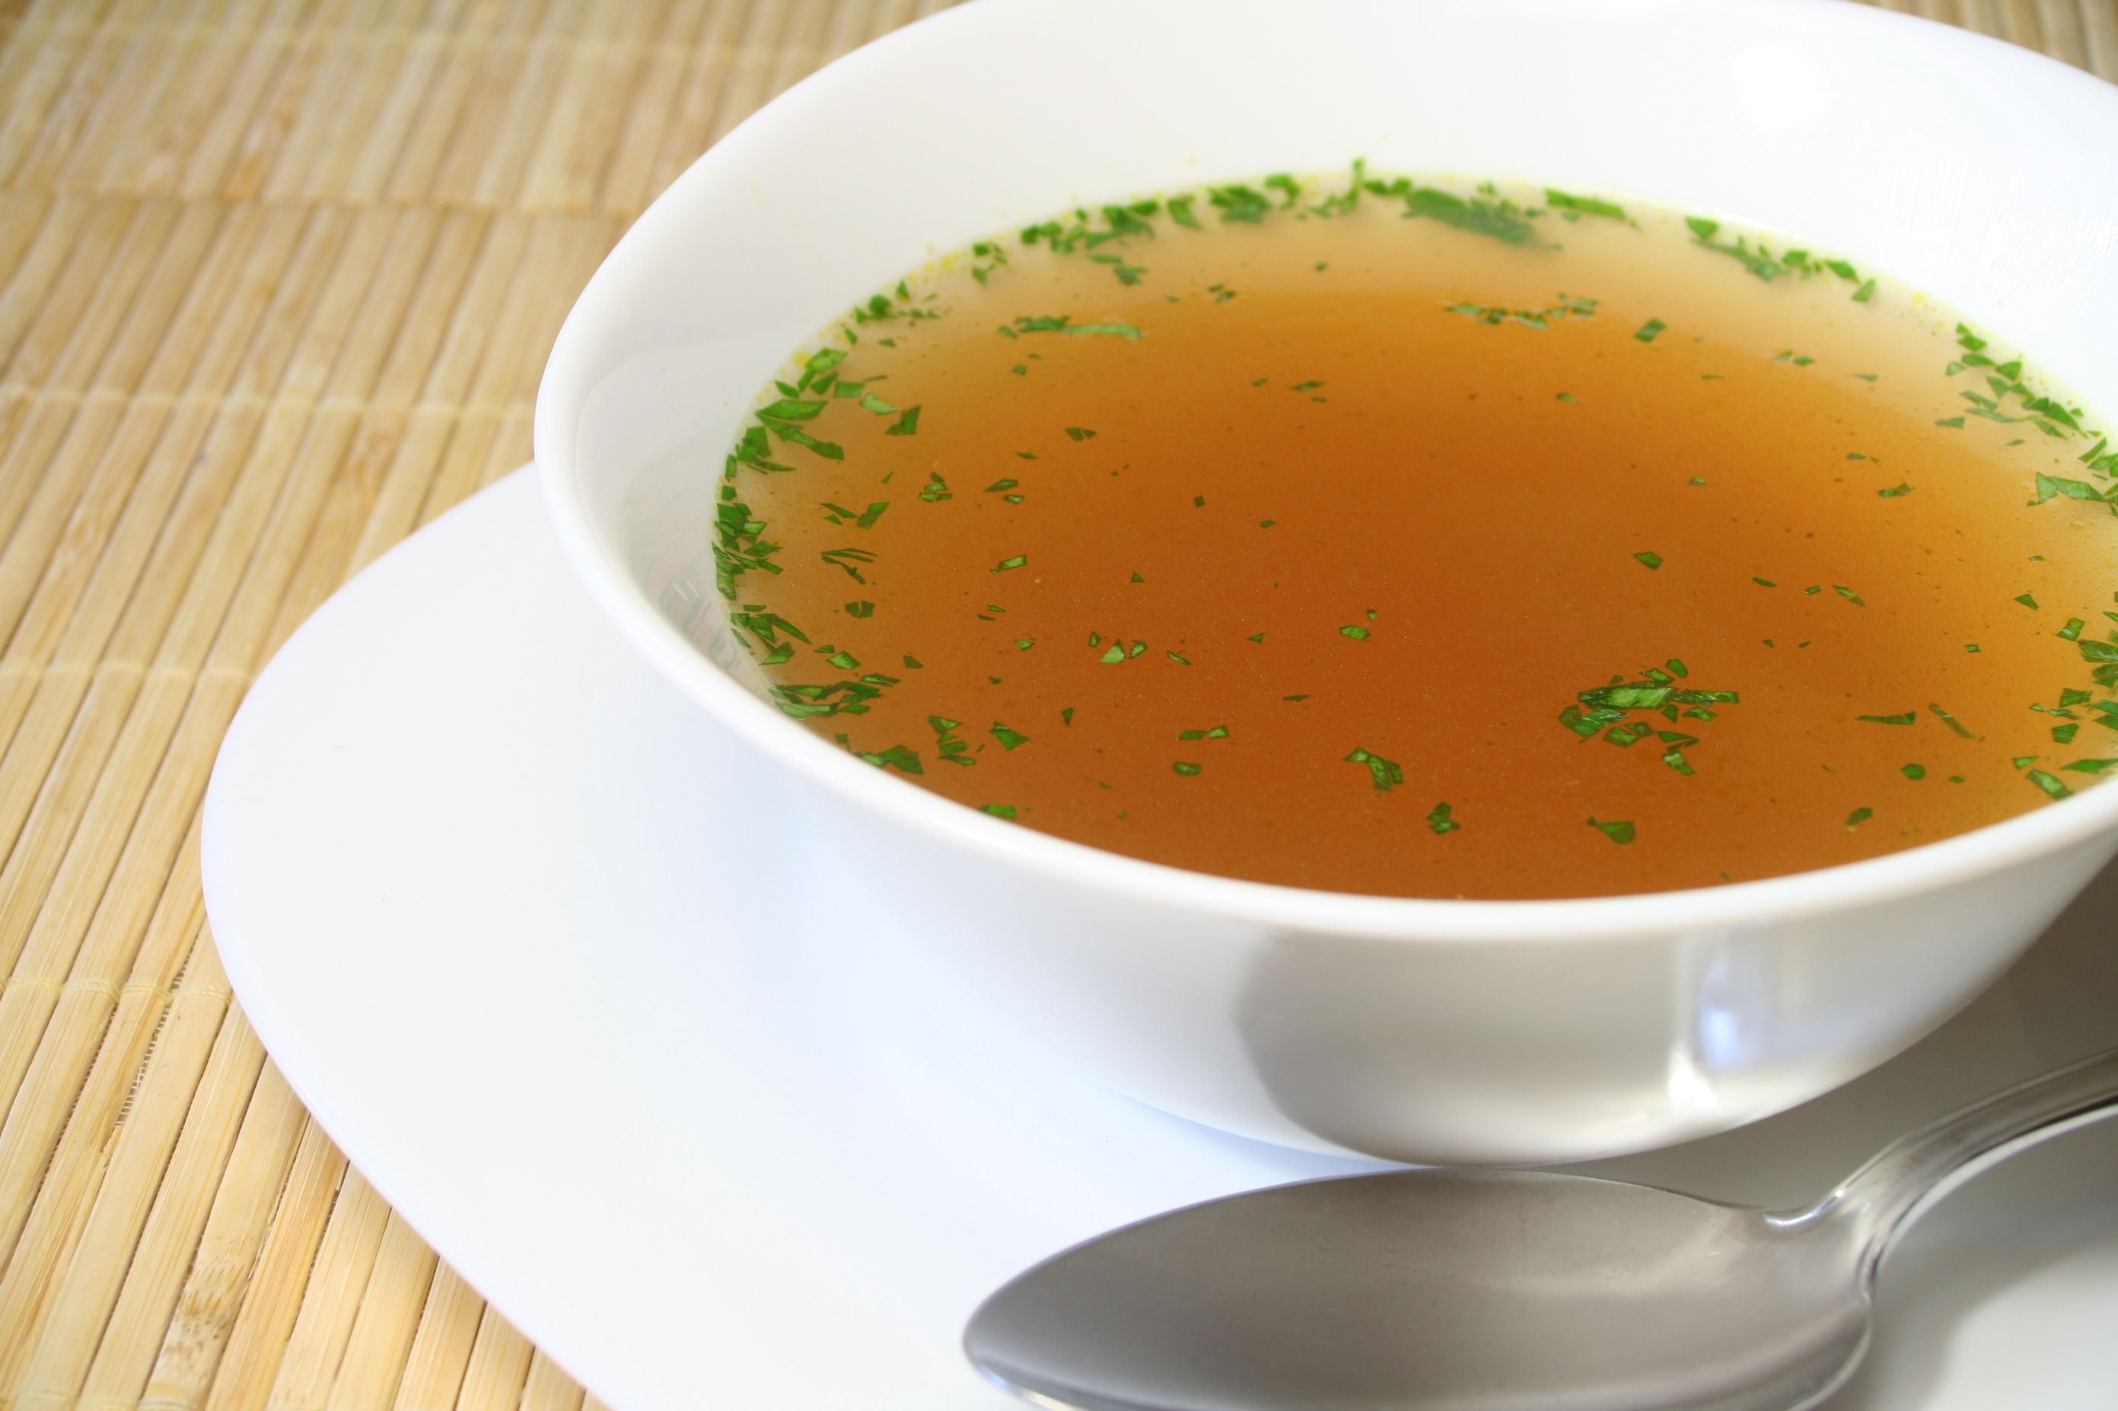
CLASSIFICATION OF STOCKS
1. CHICKEN STOCK
- Made from chicken bone
2. WHITE STOCK
- Made from beef or veal bone

Slide 5
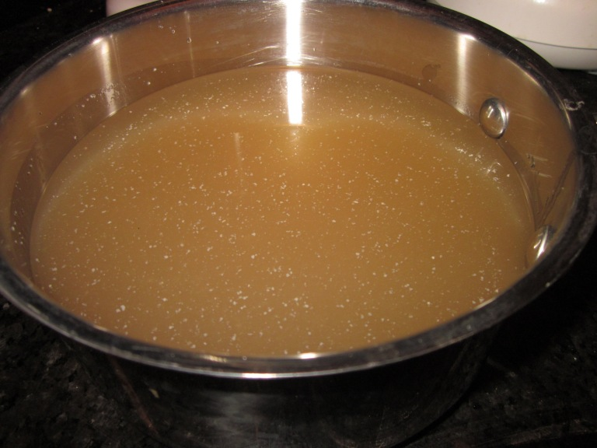
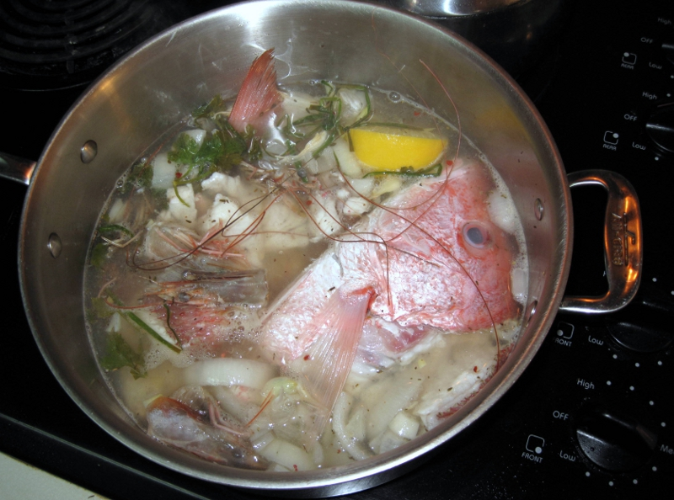
CLASSIFICATION OF STOCKS
3. BROWN STOCK
- Made from beef or veal bone that have been browned in an oven.
4. FISH STOCK
- Made from fish bone and trimmings left over after filleting.

Slide 6
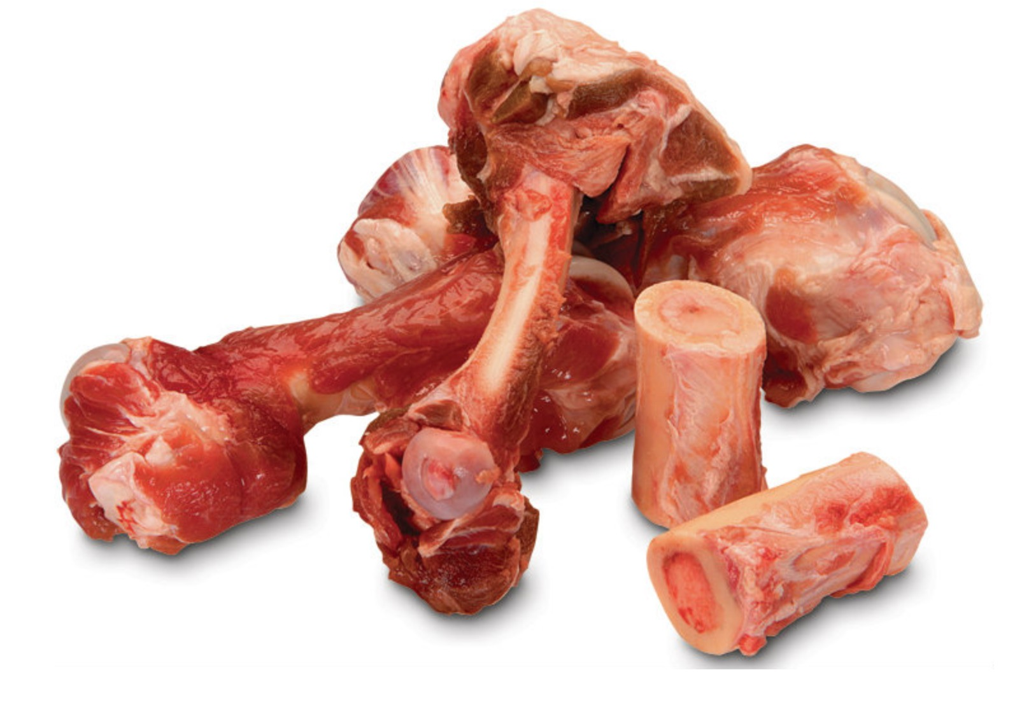
INGREDIENTS IN PREPARING STOCKS
Bones Most of the flavor and body of stocks are derived from the bones of beef, veal, chicken, fish, and pork. The kinds of bones used determine the kind of stock, except vegetable stock.

Slide 7
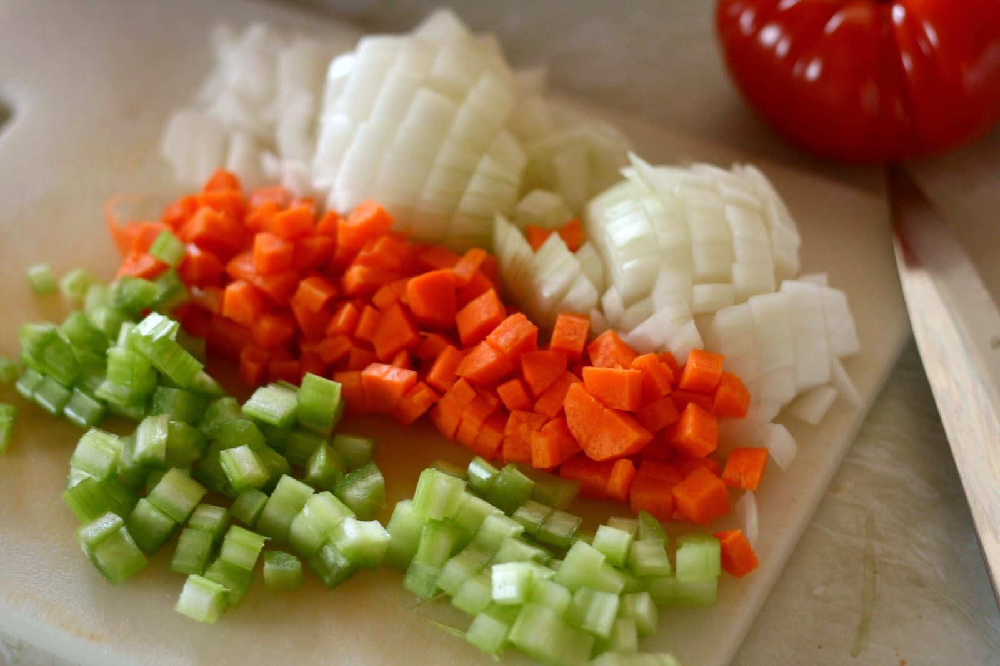
INGREDIENTS IN PREPARING STOCKS
2. Mirepoix - is the French term for the combination of coarsely chopped onions, carrots and celery used to flavor stocks. Basic formula for Mirepoix - used to flavor white stocks and soups, tomato paste or puree is often included for brown stock, gravy, stew or soup. 2 parts onion 1 part celery 1 part carrot

Slide 8
INGREDIENTS IN PREPARING STOCKS
3. Acid products - Acid helps dissolve connective tissues, and extract flavor and body from bones.
4. Scraps and left-over-Scraps may be used in stocks if they are clear, wholesome, and appropriate to the stock being made.

Slide 9
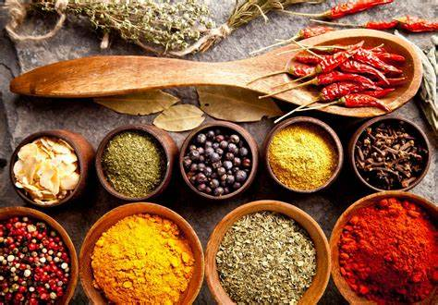
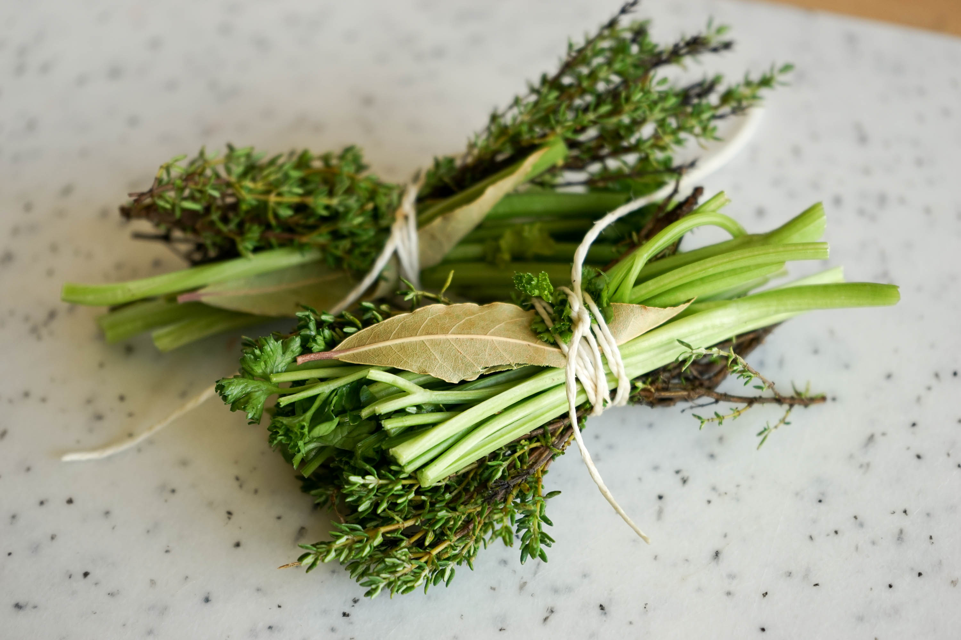
INGREDIENTS IN PREPARING STOCKS
5. Seasoning and spices
6. Bouquet garni - assortment of fresh herbs and aromatic ingredients tied in a bundle with string so it can be removed easily from the stock.

Slide 10
GUIDELINES IN PREPARING STOCKS
1. Follow the correct procedures for cooling and storing stock and make sure that any stock you use is flavorful and wholesome. 2. Follow the cooking time for stock The following are approximate cooking time for different stocks; the time will vary according to numerous factors such as ingredients quality, volume and cooking temperature. White beef stock - 8 to 10 hours White and brown Veal Game stock-6 to 8 hours White poultry and Game Bird Stocks -3 to 4 hours Fish Stock-45 minutes to 1 1 hour Vegetables Stock-45 minutes to 1 hour, depending on the specific ingredients and the size of vegetables cut

Slide 11
GUIDELINES IN PREPARING STOCKS
3. The stock ingredients are boiled starting with cold water. This promotes the extraction of protein which may be sealed in by hot water. 4. Stocks are simmered gently, with small bubbles at the bottom but not breaking at the surface. If a stock is boiled, it will be cloudy. 5. Salt is not usually added to a stock, as this causes it to become too salty, since most stocks are preserved to make soup and sauces. 6. Meat is added to the stock before the vegetables and the "scum" that rises to the surface skimmed off before further ingredients are added

Slide 12
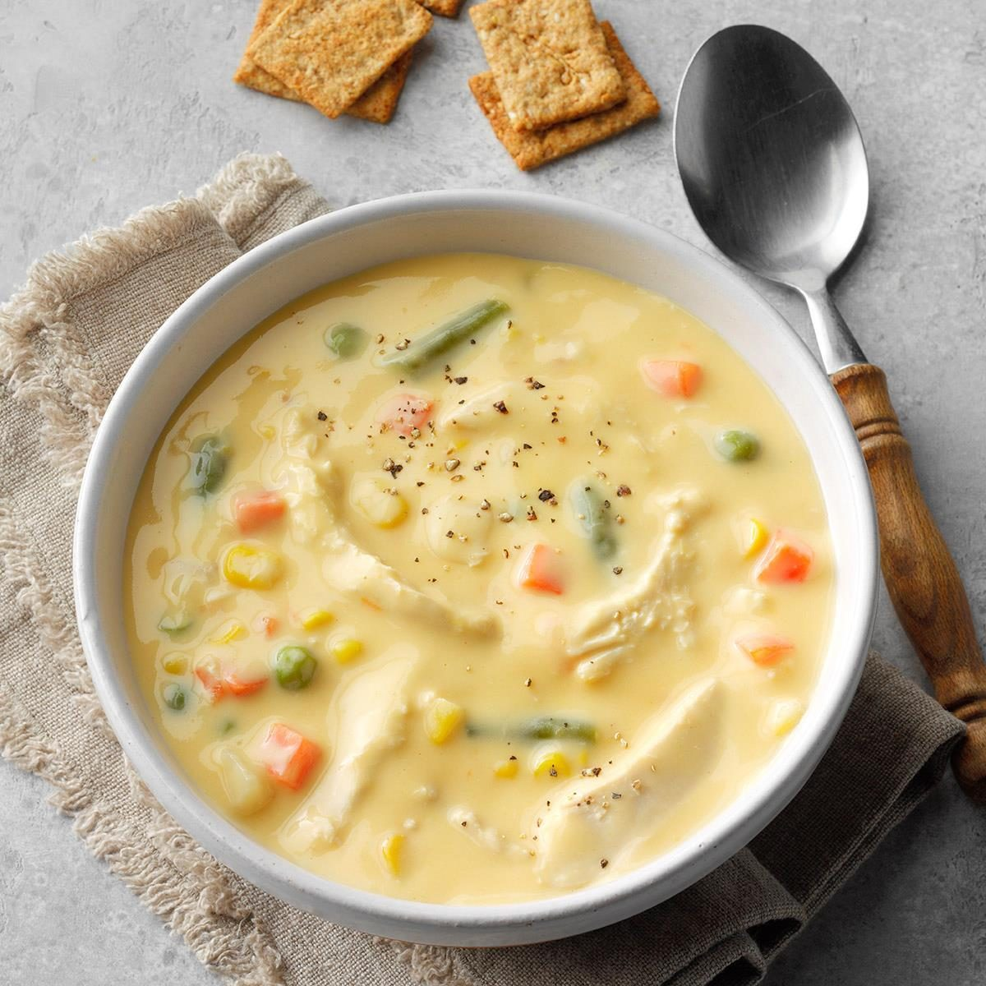
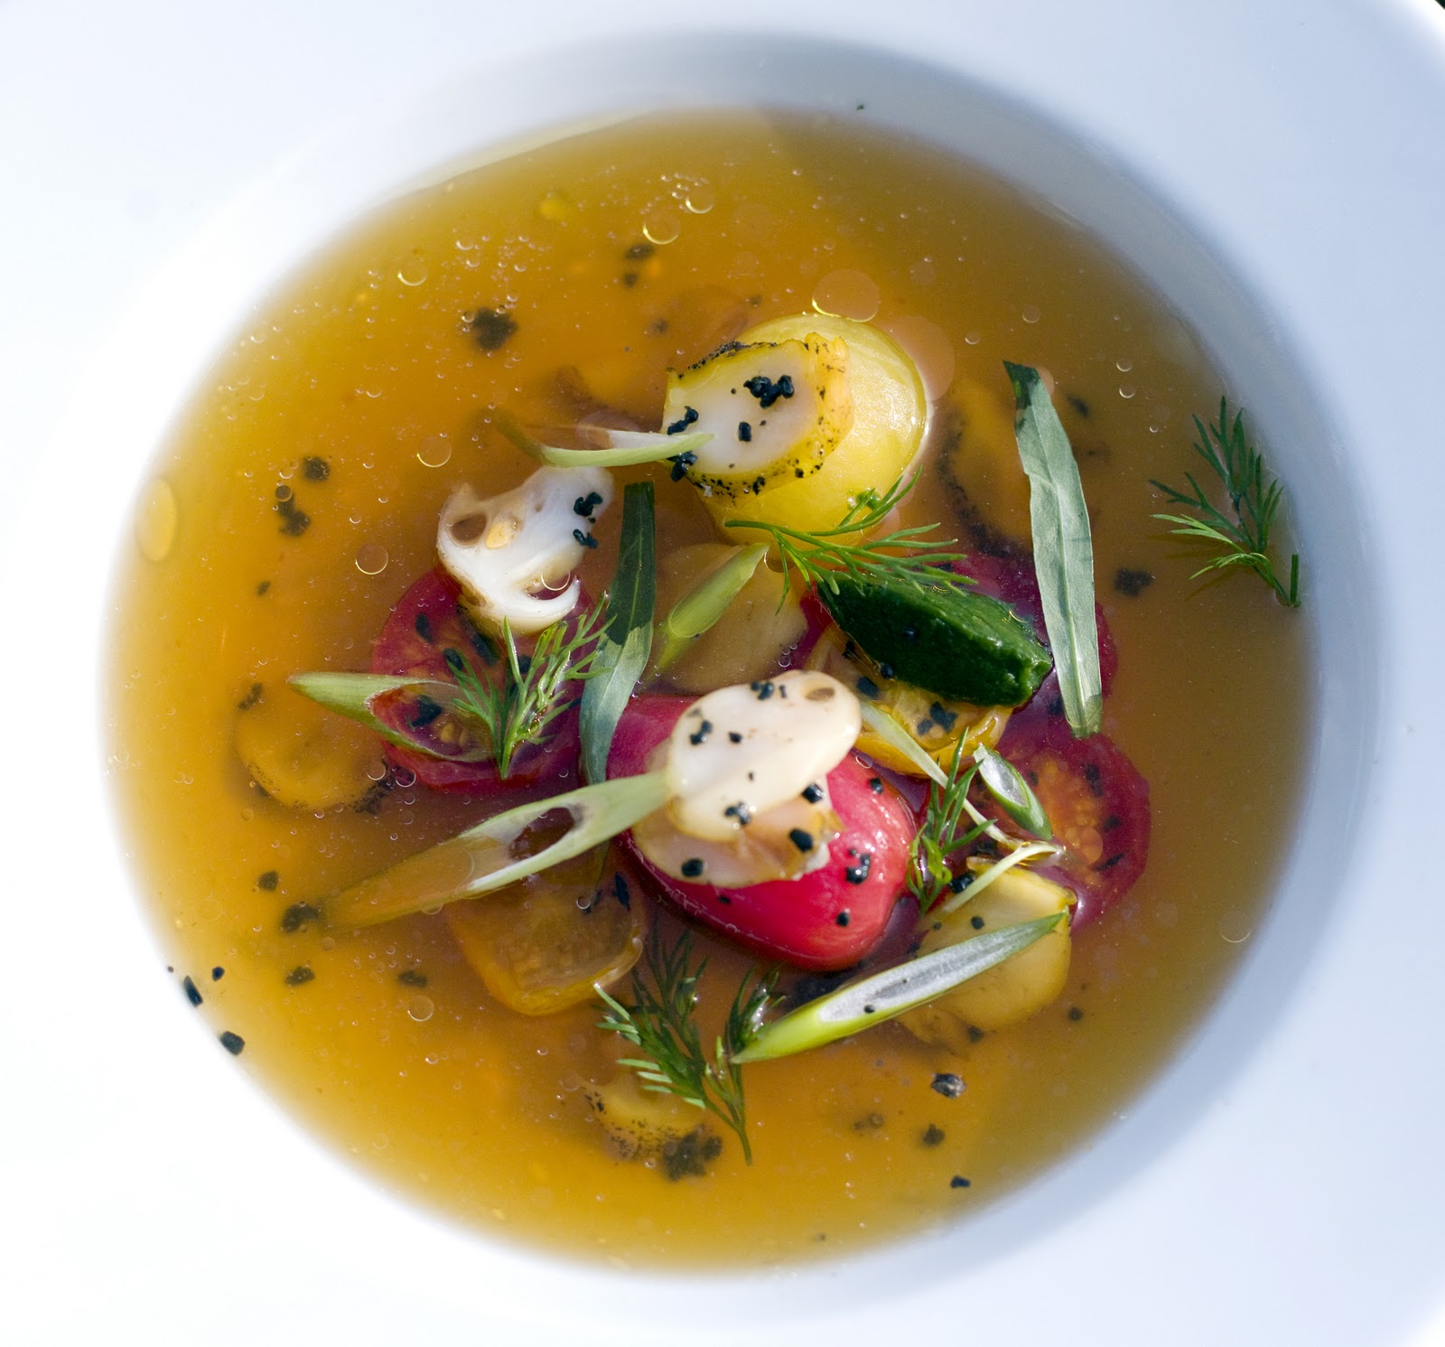
Prepare Soups Required for Menu Item Soups

Slide 13
SOUP
-are based on stocks added with other ingredients for variety of flavor, consistency, appearance and aroma. A well-prepared soup always makes a memorable impression. Soups offer a full array of flavoring ingredients and garnishing opportunities. Soups also allow the use of trimmings and leftover creatively.

Slide 14
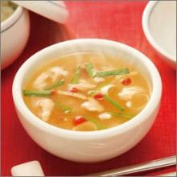
CLASSIFICATION OF SOUP
1. Clear Soups They are soups based on a clear, unthickened broth or stock. They may be served plain or garnished with a variety of vegetables and meats. They are very similar to stocks, except that broths are based on meats rather than bones so they are richer and have a more defined flavor. Broths can be used as a liquid in preparing soups. A good quality broth should be clear, aromatic and rich-tasting with a very evident flavor of the major ingredient. One strong and clear broth or stock is a consommé. It is made by combining lean chopped meat, egg whites, mirepoix, herbs and spices and an acidic ingredient like tomatoes, wine, or lemon juice. The combination is called "clarification" since the particles that make the broth appear cloudy are trapped as it cooks. A good quality consommé is crystal - clear, has a good body, amber to brown in color, and completely fat-free.

Slide 15
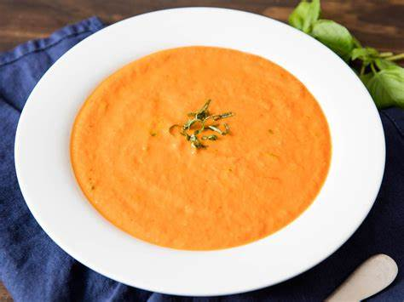
CLASSIFICATION OF SOUP
2. Thick Soups
-are soups that are thickened to provide a heavier consistency. Thick soup is a cream soup based on béchamel sauce and is finished with a heavy cream. A béchamel sauce is milk thickened with roux. But some thick soups are veloute sauce-based, stock thickened with roux.

Slide 16
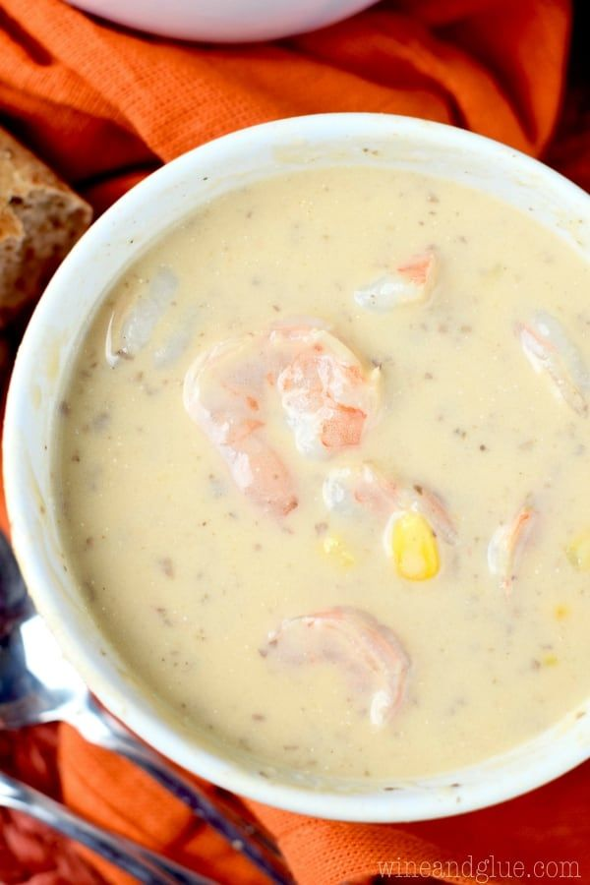
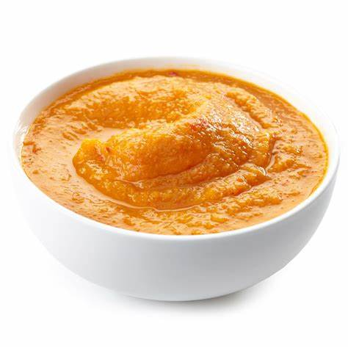
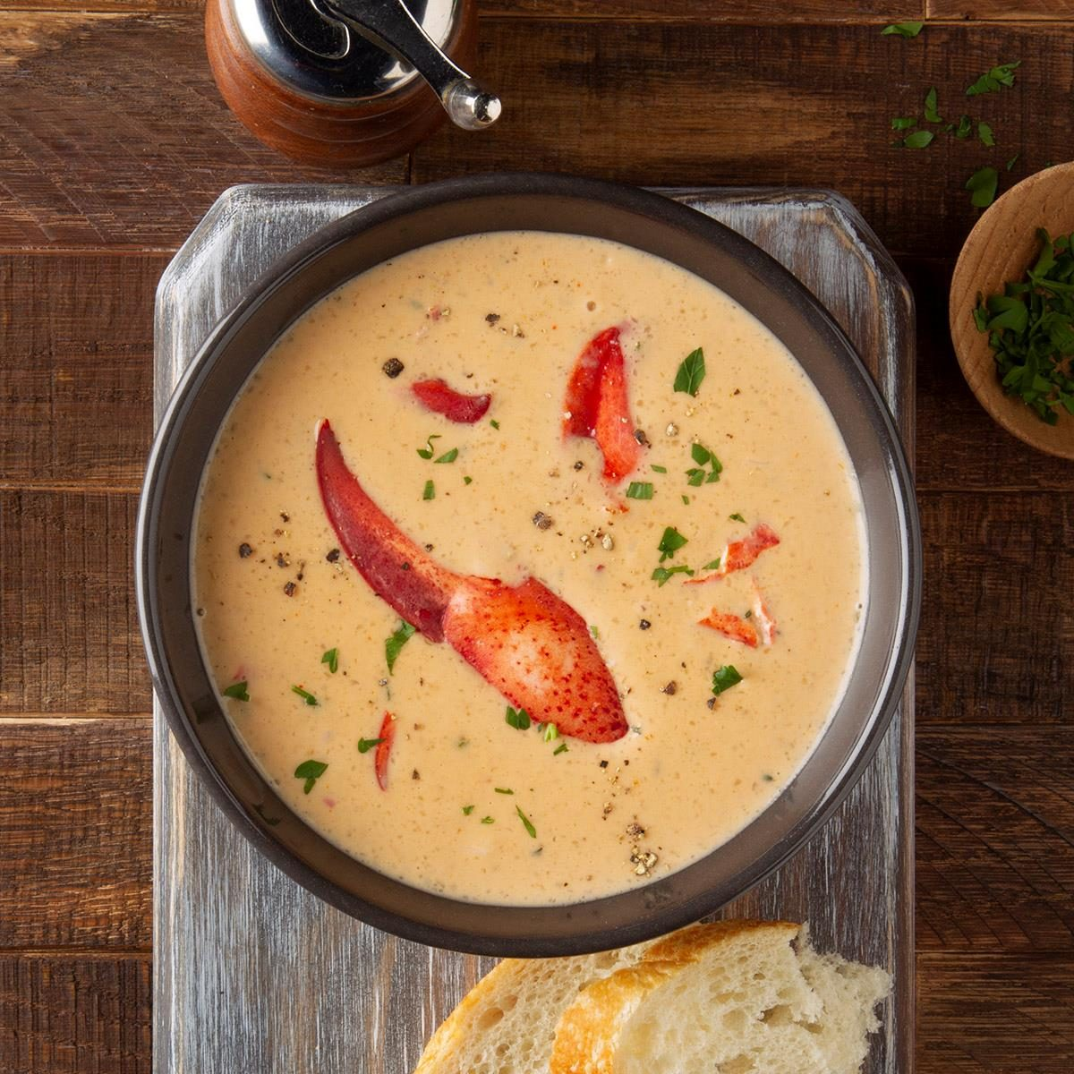
EXAMPLE OF CREAM SOUP
Cream soups are soups thickened with roux, beurremanie, liaison or other thickening agents, plus milk, or cream.
Purees-vegetable soup thickened with starch
Bisques are thickened soups made from shellfish.

Slide 17
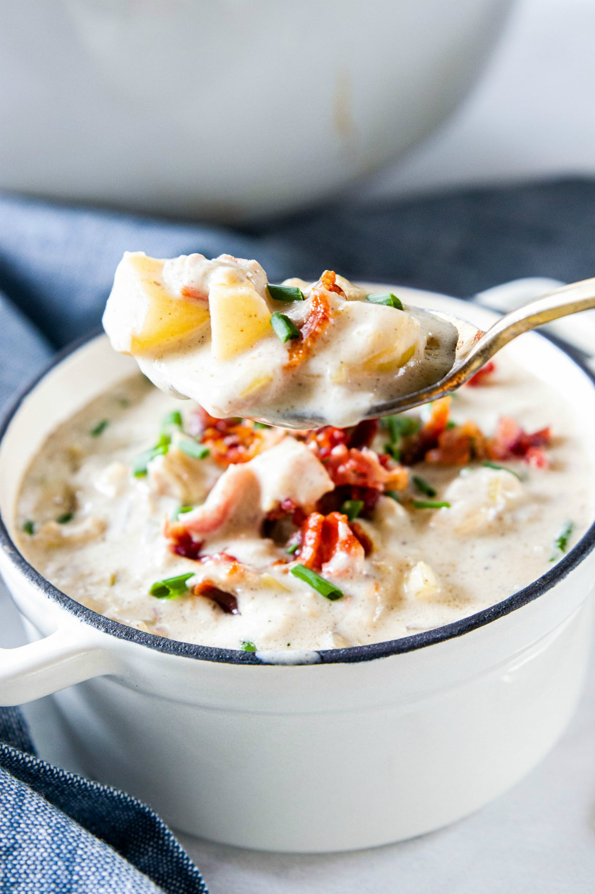
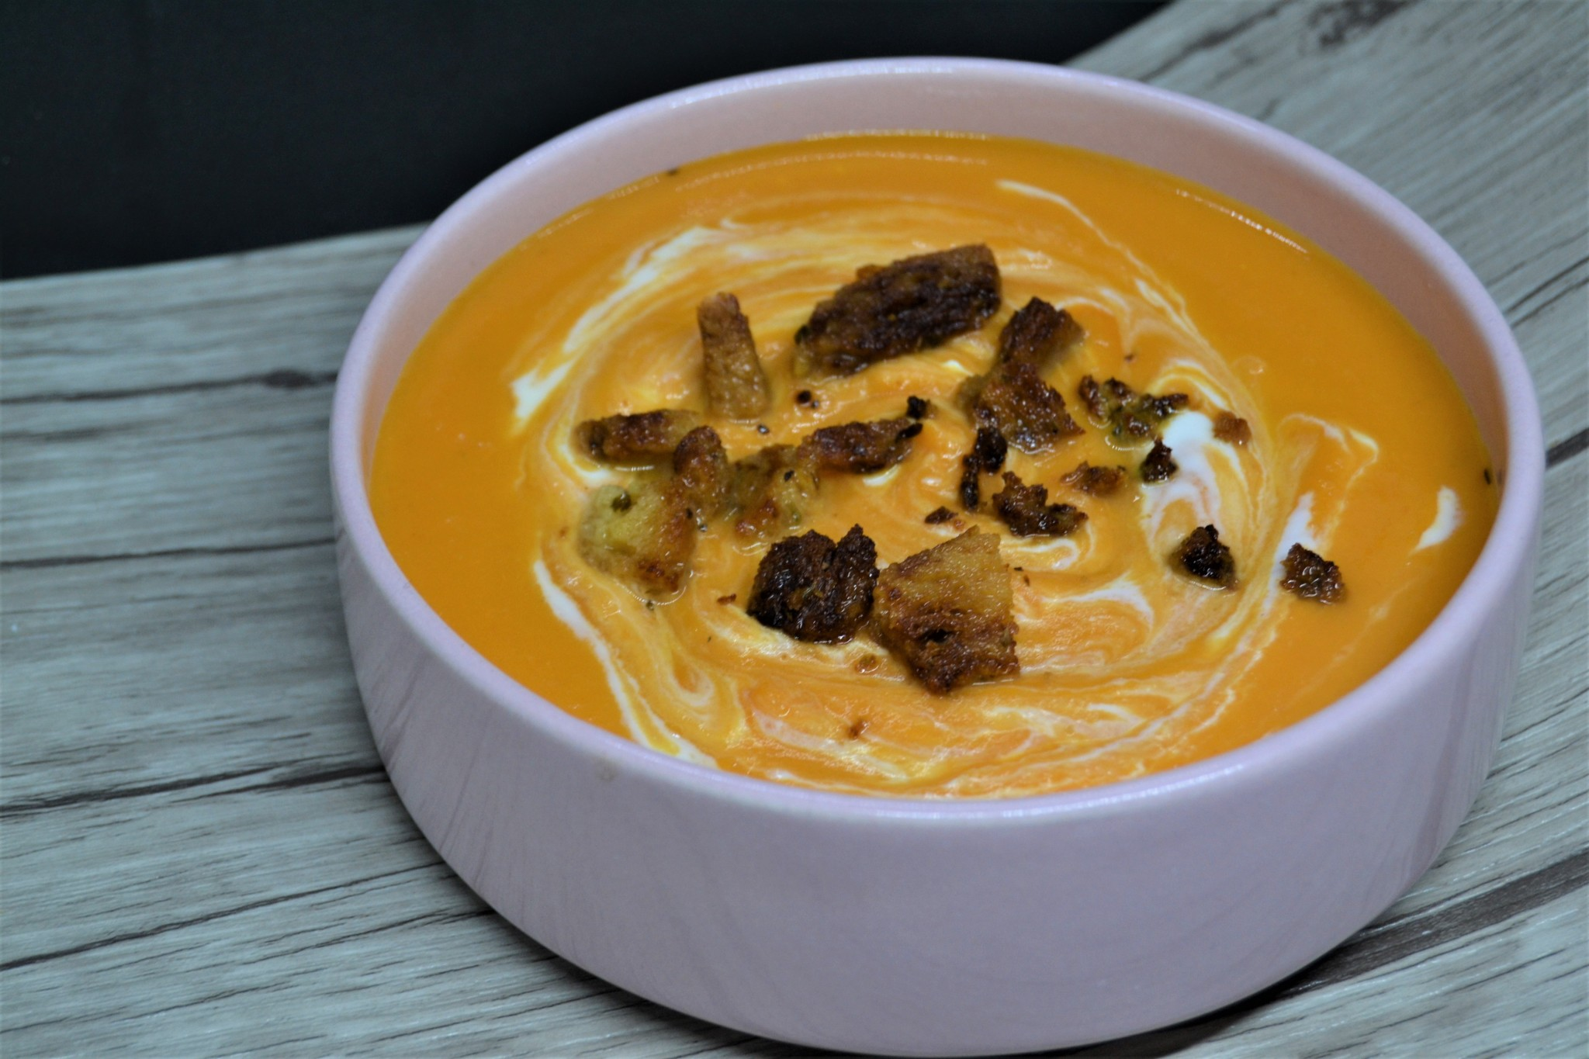
EXAMPLE OF CREAM SOUP
Chowders are hearty soups made from fish, shellfish or vegetables usually contain milk and potatoes.
Veloutes - soup thickened with egg, butter and cream.

Slide 18
CLASSIFICATION OF SOUP
3. Other types of Soup.
A. Dessert Soup
EXAMPLES
1. Ginataana Filipino soup made from coconut milk, milk, fruit,and tapioca pearl served hot or cold.
2. Osheriku a Japanese asuki bean soup
3. Tonge sui- a Chinese soup

Slide 19
CLASSIFICATION OF SOUP
B. Fruit Soup can be served hot or cold depending on the recipe where dried fruits are used like raisins and prunes. Fruit soup may include milk, sweet or savory dumplings, spices or alcoholic beverages like brandy and champagne.
C. Cold soup is variations on the traditional soup wherein the temperature when served is kept at or below temperature.
D. Asian soup is a traditional soup which is typical broth, clear soup, or starch thickened soup.

Slide 20
Other thickening agents for soup
Rice
2. flour
3. grain
4. corn starch

Slide 21
BASIC PRINCIPLES OF PREPARING SOUP
1st Principle. Starting with Cold Water
Why cold water? Most protein, vitamins and minerals dissolve in cold. water. Part of the flavor comes from these components. Using hot water would lessen the flavor and nutritive content of stock
2nd Principle. Cutting vegetable to appropriate size for the type of stock. The size of cut helps the maximum flavor to be extracted. Example 1: A fish stock only simmer for a half hour (30 minutes) so the cut should be julienne (thin strips: 4 inch thick 2-3 inches long)
Example 2: A brown stock simmers for 4-6 hours and sometimes 24 hours, so the cut should be 1" cubed so that stock will have time to extract the flavor and will not fall apart after a long cooking.

Slide 22
BASIC PRINCIPLES OF PREPARING SOUP
3rd Principle. Select your protein based. Beef, Chicken, Pork and Fish
All bones are washed, roasted or blanched. Roasted for brown sauce and blanched for white stock.
4th Principle. Simmering
Gentle extractions aid in flavor and nutrition. Boiling causes cloudiness through agitation of the ingredients.
5th Principle. Skimming
Keep the stock clear. The scum on top of stocks contains impurities.

Slide 23
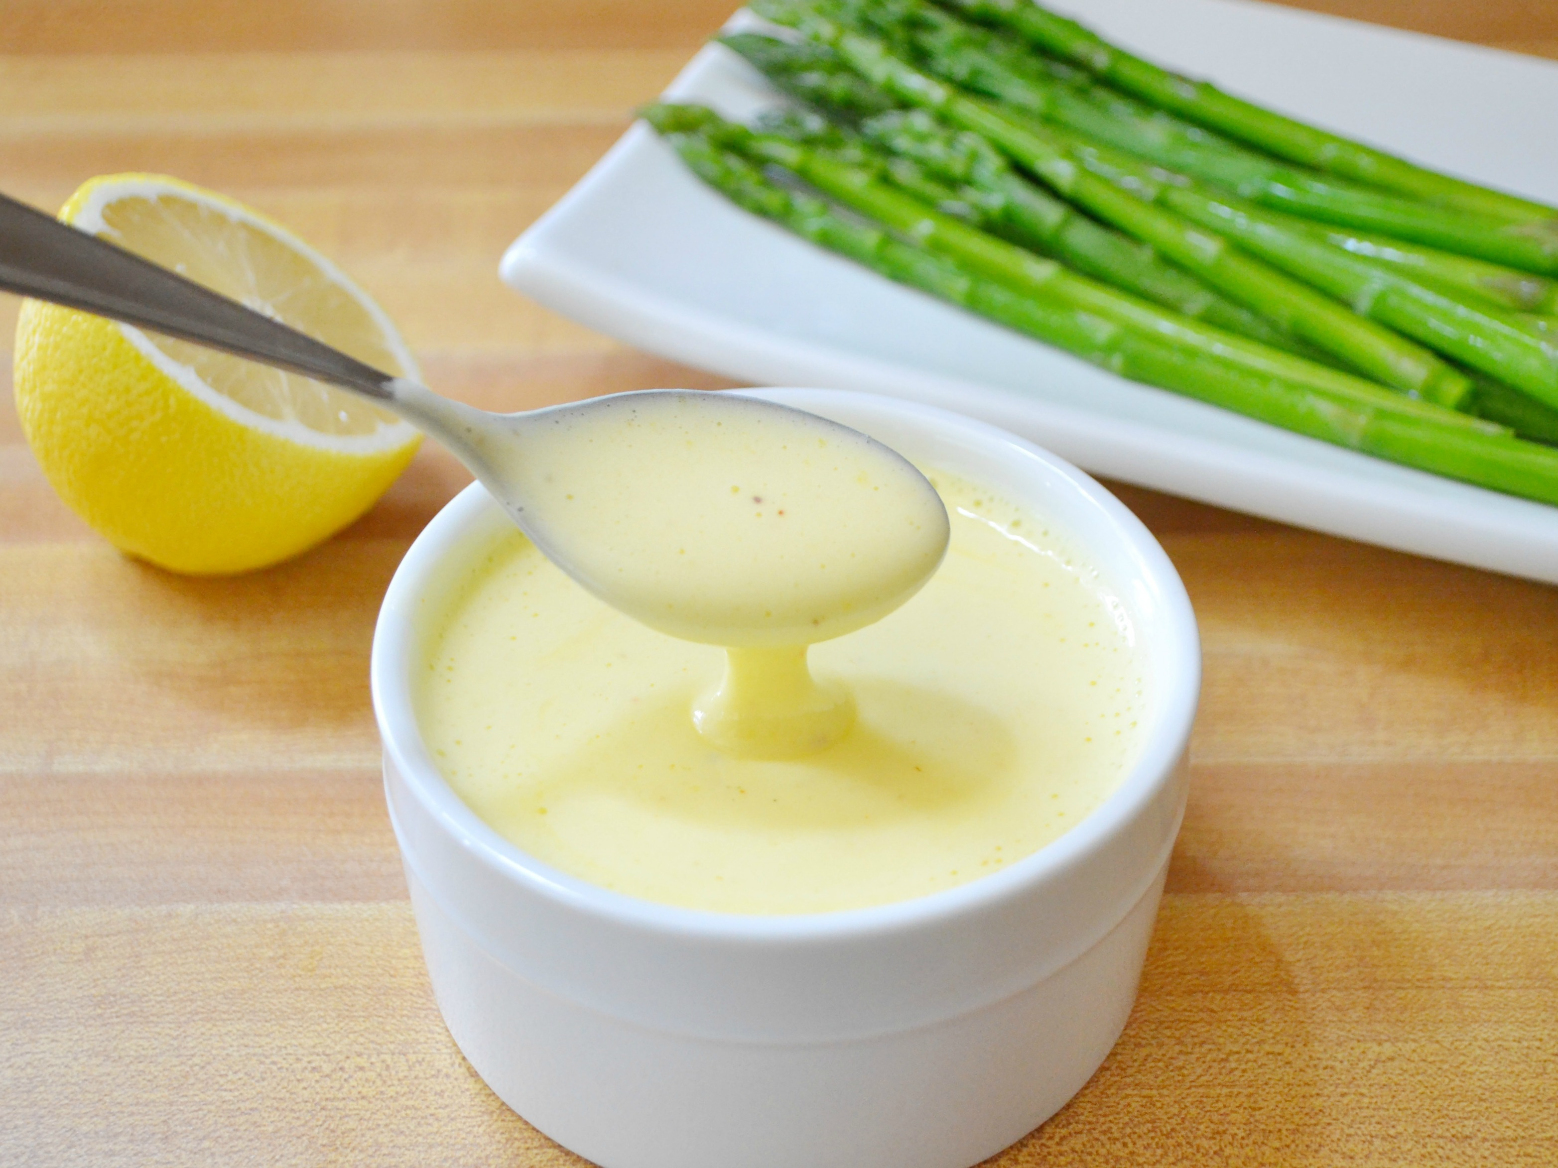
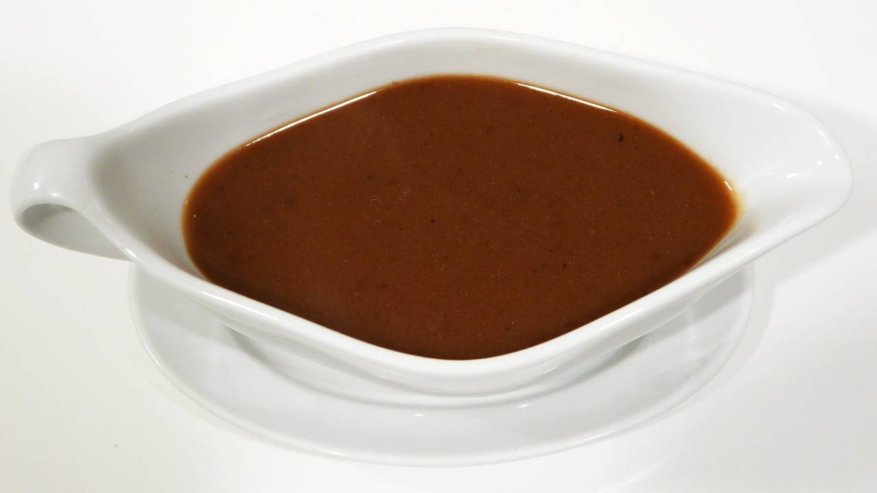
Prepare Sauces Required for Menu Item Sauces

Slide 24
One of the important components of a dish is the sauce. Sauces serve a particular function in the composition of a dish. These enhance the taste of the food to be served as well as add moisture or succulence to food that are cooked dry. Sauces also enhance the appearance of a dish by adding luster and sheen. A sauce that includes a flavor complementary to a food brings out the flavor of that food. It defines and enriches the overall taste and its texture. Sauce is a fluid dressing for poultry, meat, fish, dessert and other culinary products.

Slide 25
SAUCE
is a flavorful liquid, usually thickened that is used to season, flavor and enhance other foods. It adds:
-Moistness Flavor -Richness
-Appearance (color and shine)
-Appeal

Slide 26
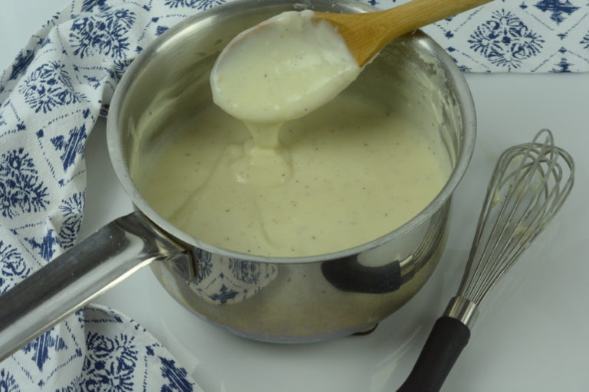
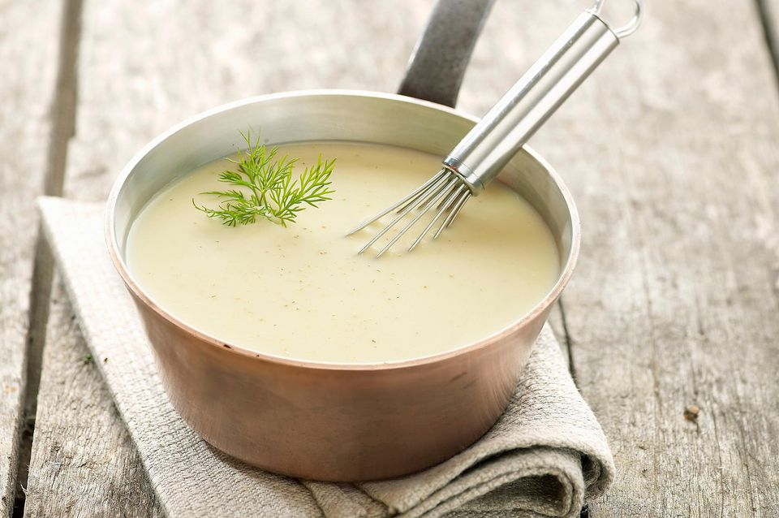
Basic Sauces for Meat, Vegetables, and Fish
1.White sauce - Its basic ingredient is milk which is thickened with flour enriched with butter. 2. Veloute sauce- Its chief ingredients are veal, chicken and fish broth, thickened with blonde roux.

Slide 27
Basic Sauces for Meat, Vegetables, and Fish
3. Hollandaise - It is a rich emulsified sauce made from butter, egg yolks, lemon juice and cayenne. Emulsion (as fat in milk) consists of liquid dispersed with or without an emulsifier in another liquid that usually would not mix together. 4. Brown sauce/Espagnole - It is a brown roux-based sauce made with margarine or butter, flavor and brown stock.

Slide 28
Basic Sauces for Meat, Vegetables, and Fish
5. Tomato It is made from stock (ham/pork) and tomato products seasoned with spices and herbs.

Slide 29
VARIATION OF SAUCES
1. Hot Sauces- made just before they are to be used. 2. Cold sauces - cooked ahead of time, then cooled, covered, and placed in the refrigerator to chill.

Slide 30
THICKENING AGENT
- thickens sauce to the right consistency. The sauce must be thick enough to cling lightly to the food. Starches are the most commonly used thickeners for sauce making. Flour is the principal starch used. Other products include cornstarch, arrowroot, waxy maize, pre-gelatinized starch, bread crumbs,and other vegetables and drain products like potato starch and rice flour. Starches thicken by gelatinization, which is the process by which starch granules absorb water and swell many times their original sizes. Starch granules must be separated before heating in liquid to avoid lumping. Lumping occurs because the starch on the outside of the lump quickly gelatinizes into a coating that prevents the liquid from reaching the starch inside.

Slide 31
Starch granules are separated in two ways:
• Mixing the starch with fat. Example: roux
• Mixing the starch with a cold liquid. Example: slurry

Slide 32
ROUX
is a cooked mixture of equal parts by weight of fat and flour.
A roux must be cooked so that the sauce does not have a raw, starchy taste of flour.
The kinds of roux differ on how much they are cooked.
White roux-cooked just enough to cook the raw taste of flour; used for béchamel and other white sauces based on milk.
Blond roux-cooked little longer to a slightly darker color; used for veloutes’.
Brown roux-cooked to a light brown color and a nutty aroma. Flour may be browned before adding to the fat. It contributes flavor and color to brown sauces.

Slide 33
COMMON PROBLEMS IN SAUCES
Discarding
2. oiling-off3
3. poor texture
synersis (weeping)
oil streaking

